Slide 1


PURCHASES 101
Welcome to Purchases 101!
This presentation is useful for all agency procurement user roles; Requisitioners, Contract Managers, Solicitation Developers and Leadership are encouraged to view this presentation.
Presented By:
Jay Hauser, State Purchasing Agent
Amanda Rivers, Deputy Purchasing Agent
Meredith Skelly, Deputy Purchasing Agent
This Photo by Unknown Author is licensed under CC BY-NC

Slide 2







 | Working with the Division of Purchases
 | R.I. Gen. Laws § 37-2-1, et. seq. (“State Purchases Act”)
 | Procurement Regulations and General Conditions of Purchase
 | Public Procurement Concepts
 | Determining the Procurement Method
 | Access to Agency Resources
 | Code of Ethics and Professional Behavior
TABLE OF CONTENTS

Slide 3

WORKING WITH THE DIVISION OF PURCHASES
MISSIONS AND FUNCTIONS
  The Division of Purchases is the centralized procurement authority for the State Of Rhode Island.
  Our goal is to obtain the best value for the taxpayer.
  This can be accomplished by providing an “equal playing field” for all potential vendors; enhancing opportunities for small businesses, minority/ women owned businesses, and disability business enterprises; and by leveraging State purchasing power on all procurements.

Slide 4

WORKING WITH THE DIVISION OF PURCHASES
STAFF STRUCTURE AND WORKLOAD
  36 staff including 3 Senior Level Commodity Team Leads (Health & Human Services, Construction, Goods and Services) and 15 Procurement Specialists.
  Annually solicit over 1,000 bids which includes Requests for Proposal (RFP), Requests for Quote (RFQ) and Requests for Information (RFI).
    Not inclusive of sole/single source requests, emergency procurements, mini-bids, or grants/delegated authority.
  Management of the life cycle of contracts, e.g., change order process.
  Consultative services to agencies and vendors and MPA contract management.
Notes:
Re-pull solicitation number

Slide 5
DOA Director Chief Purchasing Officer Jonathan Womer
State Purchasing Agent Jay Hauser
Programming Services Officer Kelley Connors
Chief of Staff Alicia Pomfret
Deputy Purchasing Agent (Commodities) Amanda Rivers
Deputy Purchasing Agent (System Operations) Meredith Skelly
Administrator of Purchasing Systems (Construction) Thomas Bovis
Administrator of Purchasing Systems (Health & Human Services) David Francis
Administrator of Purchasing Systems (Goods & Services) Maxwell Righter
Assistant Procurement Specialist (Grants/Delegated/APRA) Douglas Loiselle
Assistant Procurement Specialist
(Records/APRA)
Andrea Smith
Assistant Procurement Specialist (Records/APRA) Dee Burton
DCAMM Contracts and Specifications, Assistant Administrator Gary Mosca
Contracts and Specifications, Assistant
Administrator
Katherine Missell
Chief Procurement Specialist Robert DeAngelis
Chief Procurement Specialist Gail Walsh
Programming Services Officer (Testing) Donna Brennan
Programming Services Officer
(Training)
Giovonah Vittorioso
Assistant Procurement Specialist (Supplier Coordinator) Donald Paquin
Assistant Procurement Specialist
(Supplier Coordinator)
Amanda Menard
Procurement Specialist II Clarisa Encarnacion
Senior Procurement Specialist Gerald Teixeira
Chief Procurement Specialist (DOT) Michael [Scott] Stephens
Procurement Specialist II Luke Lawrence
Senior Procurement Specialist Jonathan Nadeau
Senior Procurement Specialist Marisa DelFarno
Assistant Procurement Specialist Jonathan Valdez
Procurement Specialist I Bridgette Dubois
Procurement Specialist II Frederick Cavallaro
Procurement Specialist I Austin Goodness
Procurement Specialist I (DOT) Colleen Brousseau
Assistant Procurement Specialist Diane Silva
Procurement Specialist I Matthew Wood
Assistant Procurement Specialist Hannah Cariati
Assistant Procurement Specialist Max Baker
Assistant Procurement Specialist (DOT) Nizayah Dalomba Correia

Slide 6


WORKING WITH THE DIVISION OF PURCHASES:
Benefits of Agency Partnerships
An upfront investment in strategy and needs assessment, and Purchases partnership, can lead to a more effective and timely procurement process.
For best outcomes:
  Upfront needs assessment
  Open dialogue with agency stakeholders
Cooperative procurement planning reduces delays caused by:
  Bid protests/legal challenges
  Unclear agency objectives and strategy
  Poor or overly ambitious timeline management at agency level
  Insufficient funding
06

Slide 7


PUBLIC PROCUREMENT CONCEPTS
Full & Open Competition
Transparency
Established Procedures
Support of Socioeconomic Goals
07

Slide 8
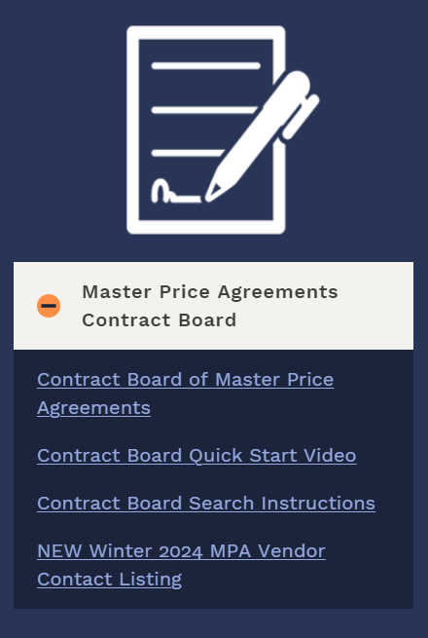
MASTER PRICE AGREEMENTS [“MPAs”]
  Solicited by Purchases for Statewide use based on universal needs for goods/services.
  Create your own release/direct Purchase Order or multi-year Purchase Agreements.
  Multistate cooperative agreements (NASPO, Sourcewell, US Commodities, Omnia Partners, etc.).
  MPAs are listed on Purchases’ Master Price Agreements Contract Board.
  If you have a suggestion for a new MPA, please work with the Division of Purchases directly.
08

Slide 9
  Useful in instances where there is no eligible MPA for goods/services.
  Agencies must obtain a minimum of three quotes and award based on lowest cost.
  $500.00 - $10,000.00 for goods and services; $500.00 - $25,000.00 for construction.
SMALL PURCHASES DELEGATED AUTHORITY
09

Slide 10
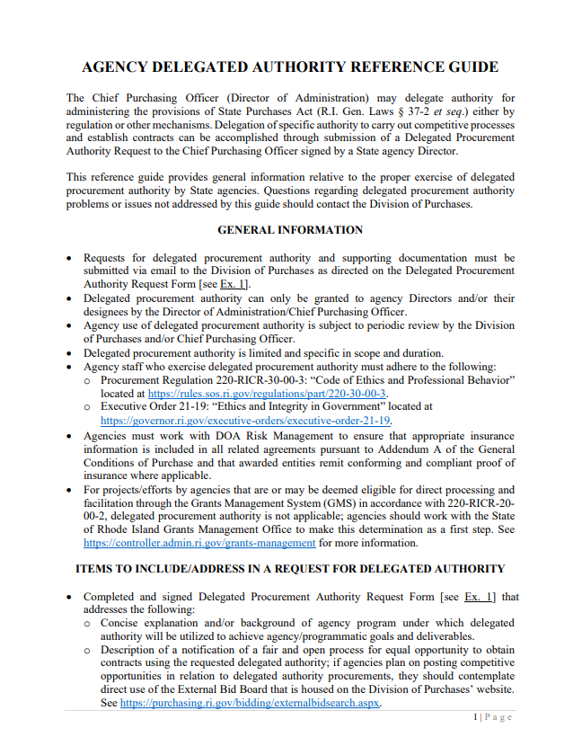
DELEGATED PURCHASE AUTHORITY FOR AGENCIES
  Available ONLY to agencies granted specific delegated authority.
  Authorization issued by DOA Director/Chief Purchasing Officer.
  Request for delegated authority reviewed by DOA Director [Chief Purchasing Officer].
  Program/Agency-Specific
    Limited in scope and duration based on request.
10

Slide 11

ARCHITECTURAL, ENGINEERING, OR CONSULTANT SERVICES
Under $20,000 (R.I. Gen. Laws § 37-2-69)
  Agency must obtain a minimum of three written quotes from eligible vendors via direct email outreach.
  Every effort should be made to contact Rhode Island vendors and at least one Minority Business Enterprise (“MBE”) vendor.
  Agency recommends award to lowest responsive, responsible bidder.
  Agency submits requisition with all quotes, recommendation, and specific request form located in the Agency Procurement Library.
    Vendor must be fully registered to issue a Purchase Order.
  DOA Director/Chief Purchasing Officer must issue final approval.
11

Slide 12



Slide 13
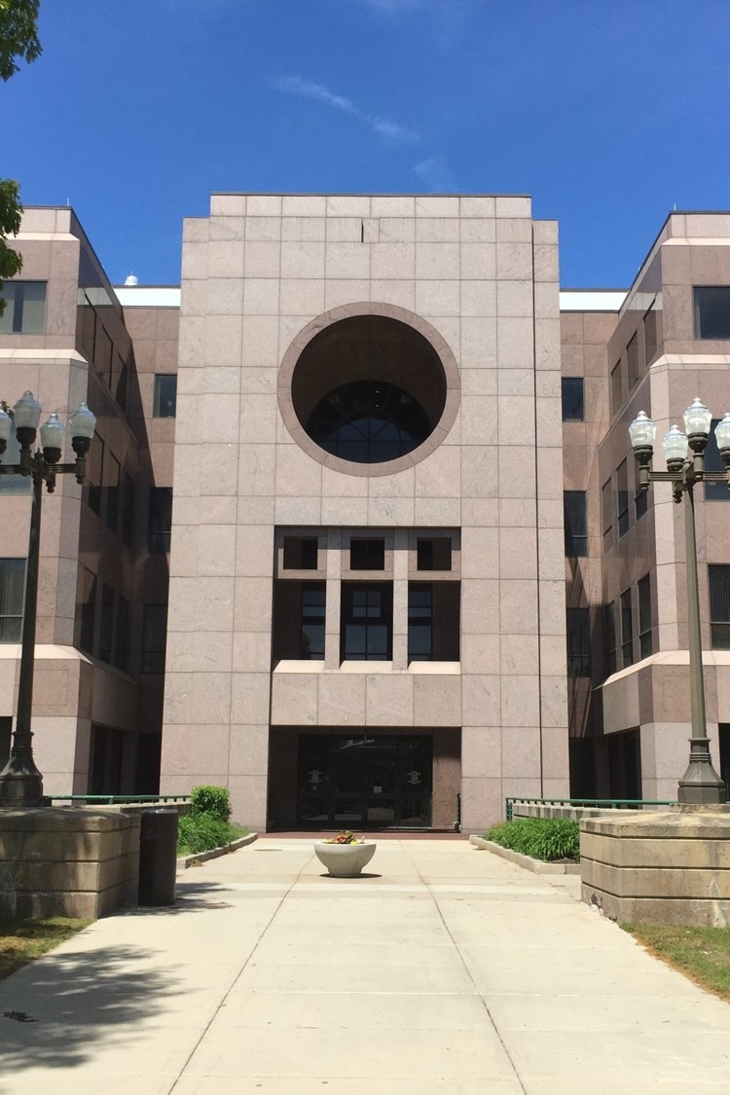
If there is no MPA and need does not fall within Small Purchases Delegated Authority or Agency-Specific Delegated Authority, interface with the Division of Purchases

Slide 14

QUESTIONS?
14

Slide 15

METHODS OF PUBLIC SOLICITATION
  Request for Quotations: RFQ
  Request for Qualifications: Solicitation Type Varies
  Request for Information: RFI [No Award]
  Request for Proposals: RFP
15

Slide 16
WORKING WITH THE DIVISION OF PURCHASES:
Market Research Options - Request for Information (RFI)
The RFI is a market research tool used to gain expertise from industry leaders.
Option | Description | Application | Timing
RFI: No award | Collects written information about the capabilities of the market. Interview/demo is an additional option available Information used to develop robust, on-target RFP scope of work Agency is responsible for review | When agency wants additional information on available services and providers before designing the RFP Way to signal vendor interest in service area Provides open transparency of vendor outreach | Posted for 28 days 1-2 month review according to Agency timeline Allow adequate time to develop RFP that incorporates discoveries from RFI
16

Slide 17
WORKING WITH THE DIVISION OF PURCHASES:
Request for Quotations (RFQs)
Option | Description | Application | Timing
RFQ: Awarded to lowest, responsive, responsible bidder | Fixed, limited scope of work Purchases is responsible for review | Goods Construction | Posted for 28 days 1-2 week for review 21 days for tentative award 7 days for Purchase Order to issue Important: No work to commence without a Purchase Order
17

Slide 18
WORKING WITH THE DIVISION OF PURCHASES:
Requests for Proposals (RFPs)
Option | Description | Application | Timing
RFP: Awarded on best value | Incorporates a defined scope of work Technical and cost components Technical review team scores proposals based on expertise Agency is responsible for review | Typically service-based When technical expertise is critical to the project | Posted for 28 days 1-2 months for technical review 21 days for tentative award 7 days for Purchase Order to issue Important: No work to commence without a Purchase Order
Did you know?
Purchases created a check list to guide you through the RFP Process. The Agency Procurement Library should be accessed each time you draft an RFP to ensure the most current version of the RFP Template and RFP Checklist are used. Find them listed under “O & OSP”.
18

Slide 19
WORKING WITH THE DIVISION OF PURCHASES:
WHEN AND HOW TO PARTNER ON AN RFP
  RFP should be posted 9-12 months prior to existing contract expiration.
  Agency tasks/responsibilities:
      Review and update scope of work/specifications;
      Review and update evaluation criteria;
      Consider an RFI for thorough market research;
      Consult with Purchases upon approved scope of services at agency.
      Work with DOA Risk Management to obtain recommendation for appropriate insurance requirements based on project scope of work.
  Prior to submission of a requisition for solicitation posting, discuss with Purchases associated scheduling, Procurement Specialist assignment, etc.
19

Slide 20

PUBLIC PROCUREMENT PRINCIPLES: RESPONSIVE
  A proposal (bid) which conforms in all material respects to the solicitation.
  Determination takes place at the time of offer evaluation.
    RFQs = Bid opening;
    RFPs = Prior to award
  Responsiveness = Contractual Promises.
20

Slide 21

PUBLIC PROCUREMENT PRINCIPLES:
RESPONSIBILITY
Offeror has the capability, in all material respects, to perform the contract.
Capability determination is at the discretion of the State Purchasing Agent and includes:
  Experience
  Integrity
  Reliability
  Capacity
  Facilities
  Equipment
  Financial Resources & Management Capability
21

Slide 22
R.I. GEN. LAWS § 37-2-13.1
BIDDER ATTESTATIONS
  Signed into law by Governor McKee on June 29, 2022.
  Prohibits entities from bidding on Requests for Proposals if they participated in or were consulted with respect to the planning, drafting, or formulation of that Request for Proposals.
  Implementation by the Division of Purchases.
  All vendors who submit proposals in response to RFPs must execute and submit a Supplemental Bidder Attestation Form
  DOA Enterprise Policy: Here
22

Slide 23
PUBLIC WORKS (NON-RIDOT)
VENDOR PREQUALIFICATION
Prequalification of Public Works Vendors
  Vendors who wish to bid on non-Department of Transportation public works projects with an estimated value of $1,000,000 or higher must be prequalified by the Division of Purchases prior to bid.
  Prequalification is a program and not associated with any particular bid.
  A full copy of the regulation text can be found here.
23

Slide 24

REQUISITIONS: SCOPE AND PURPOSE FOR COMPETITIVE SOLICITATIONS
  Requisition (“Statement of Need” submitted by the agency:
    Confirms the agency funding source and appropriated budget amount.
    Clearly identifies the goods/services requested.
    Lists desired contract term dates.
    Authorizes the Purchasing Agent to act on behalf of the agency upon full approval of the requisition at the agency level.
24

Slide 25

SOLICITATIONS: CONFIDENTIAL/SENSITIVE INFORMATION
Agencies are responsible for the risk associated with including sensitive or confidential information and must flag such information to Purchases prior to posting.
  Collaborate with your assigned Procurement Specialist to identify confidential or sensitive information and coordinate sharing information with potential bidders separately from the OSP platform.
  Do not presume that the Division of Purchases will independently recognize agency-level confidential information; identifying/flagging such information is the responsibility of the user agency.
Examples of Confidential Information include but are not limited to:
  Personally Identifiable Information (PII);
  Protected Health Information (PHI);
  Sensitive System Design Materials or Information (e.g., State IT system infrastructure/design documents).
25

Slide 26
SOLICITATIONS: CONFIDENTIAL/SENSITIVE INFORMATION
Additional Reminders/Takeaways:
  It is the agency’s responsibility to identify and take measures to protect information that they deem “confidential” for solicitation purposes.
  Agency-identified “confidential” information in solicitations may still be subject to disclosure in the event a public records request is received; all requests are subject to R.I. Gen. Laws § 38-2-1 et. seq. (APRA).
  When in doubt about confidentiality issues, consult your agency legal team for review prior to submitting requisition to the Division of Purchases.
  The Division of Purchases is not responsible for verifying or defending against phishing attempts; please consult with agency ETSS personnel if/as needed.
26

Slide 27
RIFANS TO WORKDAY: REQUISITION TYPES
RIFANS
Workday
Workday Details
  Processing will be similar; however, Workday does have some nuances that will require some modifications to process steps.
  Job Aids (user guides) will be shared and posted to assist with the transition.
Contract Purchase Agreement
Contract
  Does not encumber funds
  Long term engagement
  No line items
  Release Req Type = Release PO from Award
Blanket Purchase Agreement (RIFANS ‘Store’)
Contract Catalog
  Does not encumber funds
  Line items
  Hosted and roundtrip catalogs
  Release Req Type = Release PO from Award
Standard Purchase Order
Purchase Order
  Encumbers funds
  Mostly one time purchase
  Release Req Type = Release PO from Award
27

Slide 28
RIFANS TO WORKDAY: TRANSACTION TYPES
RIFANS
WorkDay
Transaction Types
Contract Purchase Agreement
Contract
RFP MPA Mini Bid Sole Source MPAs
RFQ (some with longer terms or multi-release) MPA Mini Bid
RFQ (most common) SPDA MPA Mini Bid
Grants RFI (results in cancellation) Agency Contract
Blanket Purchase Agreement (RIFANS ‘Store’)
Contract Catalog
MPAs MPA Contract with Catalog Agency Contract with Catalog
Standard Purchase Order
Purchase Order
Sole Source Request from Contract (release) Grants
28

Slide 29

QUESTIONS?

Slide 30

NON-COMPETITIVE PROCUREMENTS

Slide 31
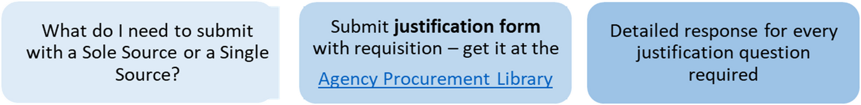
SOLE SOURCE AWARDS R.I. GEN. LAWS § 37-2-21(a)
What is a Sole Source?
A sole source procurement is a procurement where only one source is practicably available for the goods or services required.
What is a Single Source?
A single source procurement is one in which two or more vendors can supply the commodity, technology and/or perform the services required by an agency, but the State agency selects one vendor over the others for reasons such as expertise, availability, critical need or previous experience with similar contracts.
31

Slide 32
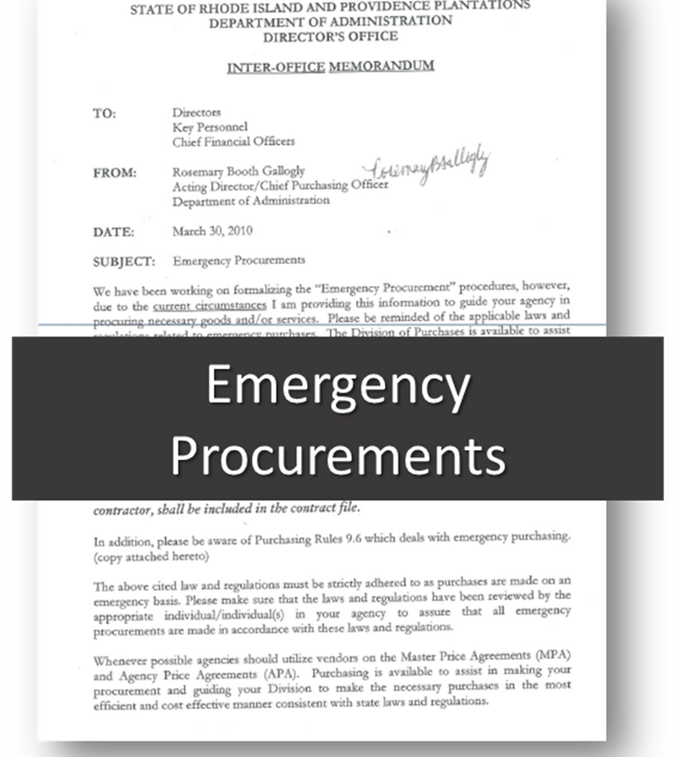
EMERGENCY PROCUREMENTS
R.I. GEN. LAWS § 37-2-21(b)
  Threat to public health, welfare or safety; failure of critical equipment; threat to property and/or necessary functions.
  Written detailed description of the basis for the emergency must be sent via email to Purchasing Agent/Deputy Purchasing Agents.
  Inadequate anticipation of need shall not be considered justification for “emergency” purchases.
  Repairs are limited to only those necessary to address the emergency situation.
  Submit all vendor invoices and required documents via a requisition.
32

Slide 33
PROCUREMENT GRANTS VS.
SUB-RECIPIENT AWARDS
  Agency initiates determinations with the Grants Management Office (GMO).
  Formal determination as to whether the entity receiving the awarded funds will be acting in a sub-recipient role or contractor role https://controller.admin.ri.gov/grants-management.
      If the resulting determination indicates that the relationship is that of a sub-recipient, the sub-award issuance process will be managed through eCivis (the Grants Management System/GMS).
      If the relationship is that of a contractor, i.e., one who delivers goods and services for consumption by the State agency, this will be considered a procurement-based grant subject to the applicable regulations/State Purchases Act.
  If/when clarity is needed, Purchases will request that agency obtains written determination from the Grants Management Team (GMO) prior to issuing a Purchase Order.
33

Slide 34
POOR VENDOR / POOR AGENCY PERFORMANCE:
CONTRACT DISPUTE/COMPLAINT PROCESS
Vendor Performance Issues
  Agency attempts to resolve first in their role as Contract Manager.
  Notify DOA/Purchases if unresolved; Contract Dispute Complaint Form available at the Agency Procurement Library.
  Resolution: compromise, suspend, debar, legal action, contract cancellation.
Agency Performance Issues
  Vendor attempts to resolve first by working directly with the agency.
  Notify DOA/Purchases if unresolved.
34

Slide 35

CODE OF ETHICS AND PROFESSIONAL BEHAVIOR
Amanda Rivers, Esquire
Deputy Purchasing Agent
35

Slide 36
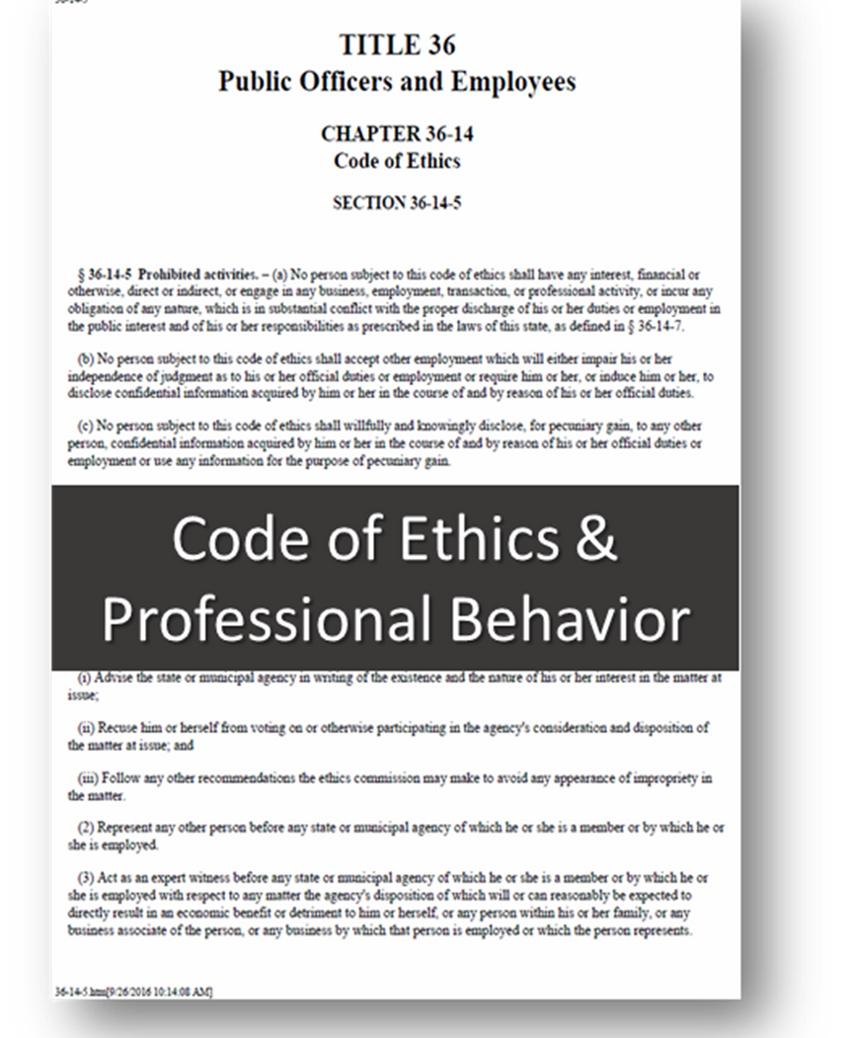
CODE OF ETHICS AND PROFESSIONAL BEHAVIOR
3.1.C Prohibited activities under the Rhode Island conflict of interest statutes (R. I. Gen. Laws § 36-14-5):
3.1.C.5 No person subject to this code of ethics or spouse (if not estranged) or dependent child or business associate of such person or any business by which said person is employed or which such person represents, shall solicit or accept any gift, loan, political contribution, reward, or promise of future employment based on any understanding that the vote, official action or judgment of said person would be influenced thereby.
36

Slide 37
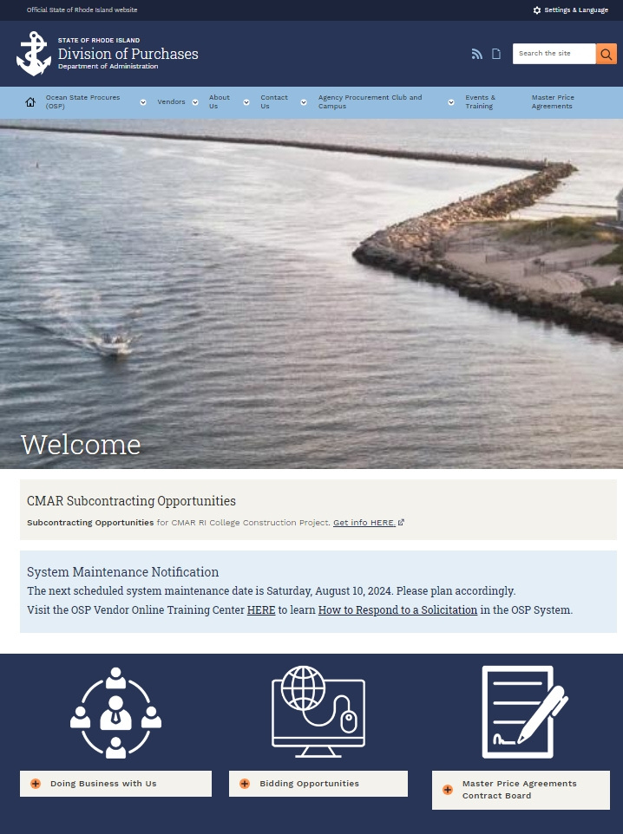
WEBSITE RESOURCES

Slide 38
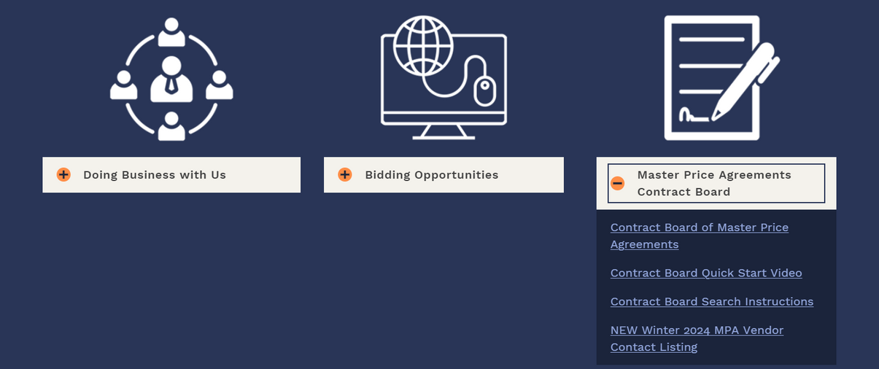
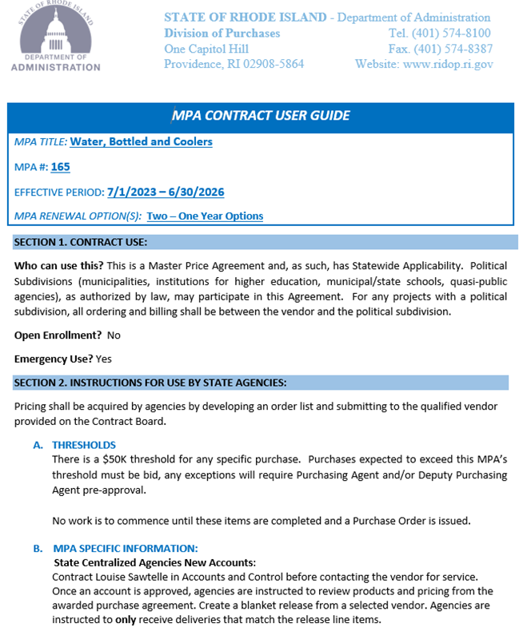
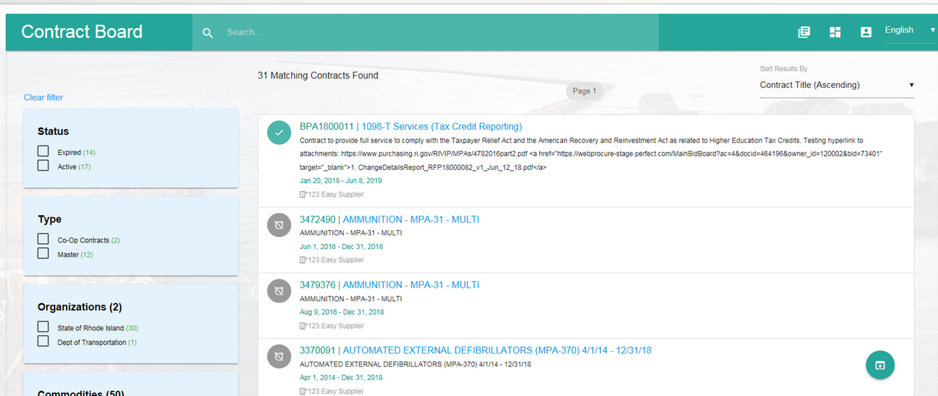
MASTER PRICE AGREEMENTS CONTRACT BOARD
A great starting point for agencies and municipalities planning to procure is to search for an MPA that fits the procurement need and procurement threshold amount.

Slide 39
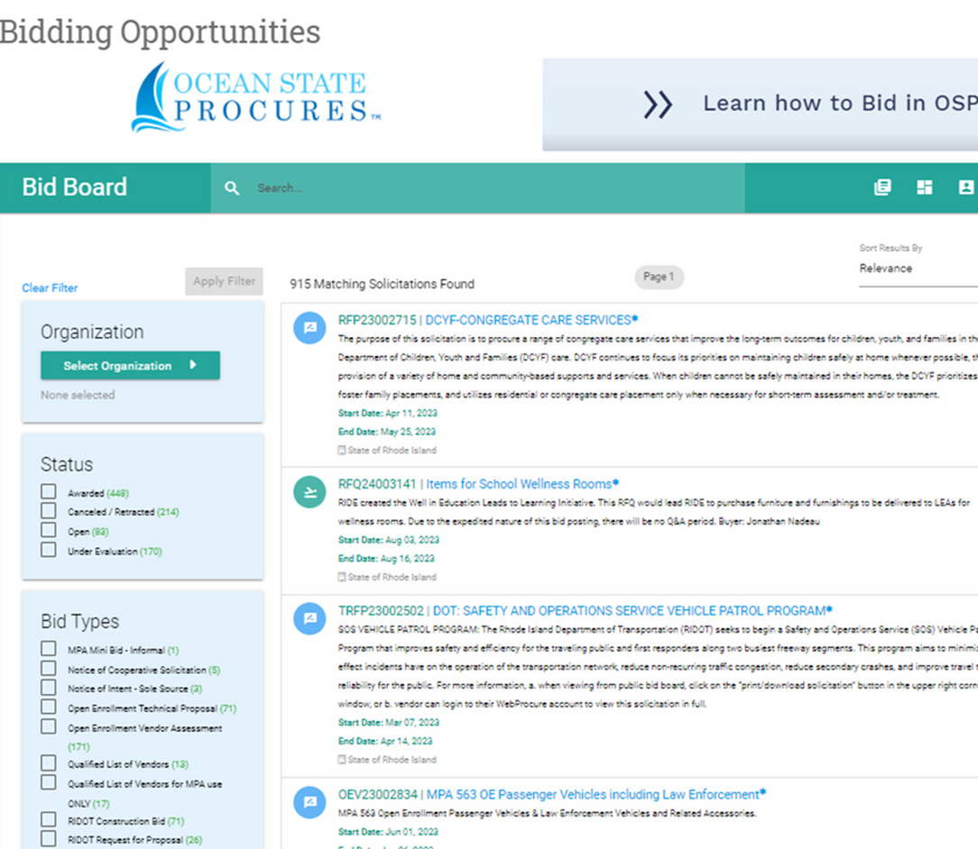
OSP BID BOARD
Agency Solicitations and Contract Awards
“View Award Reports” functionality provides enhanced transparency
39

Slide 40
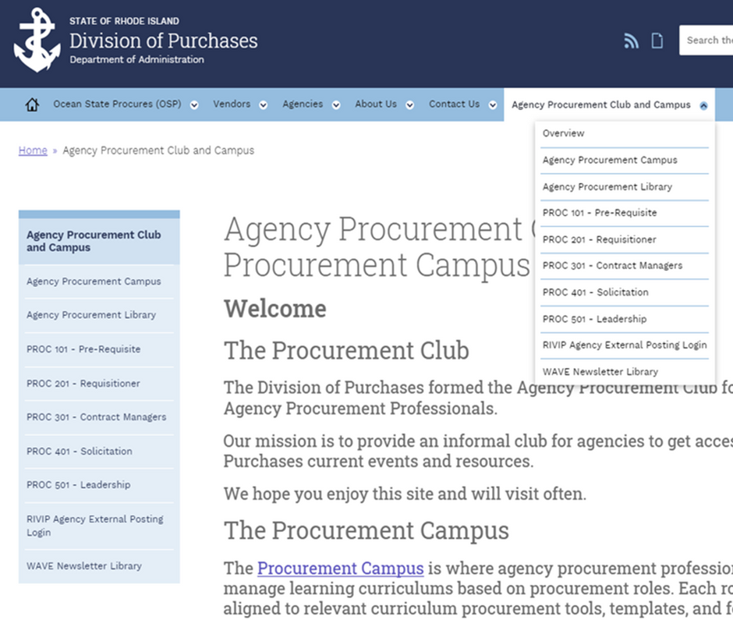
ACCESS TO
AGENCY RESOURCES
Procurement Club & Campus
Agency Procurement Club is the landing page for agency users to stay Procurement Information.
  On the RIDOP Toolbar
  Use Drop Down for Quick access
40

Slide 41
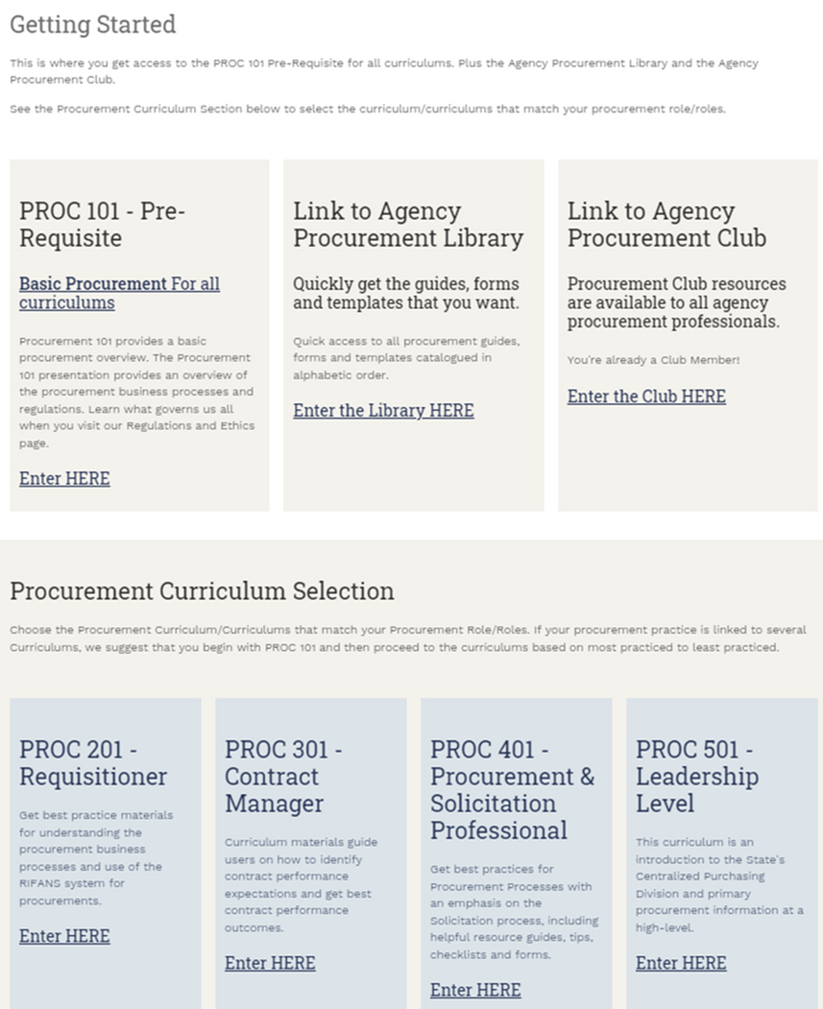
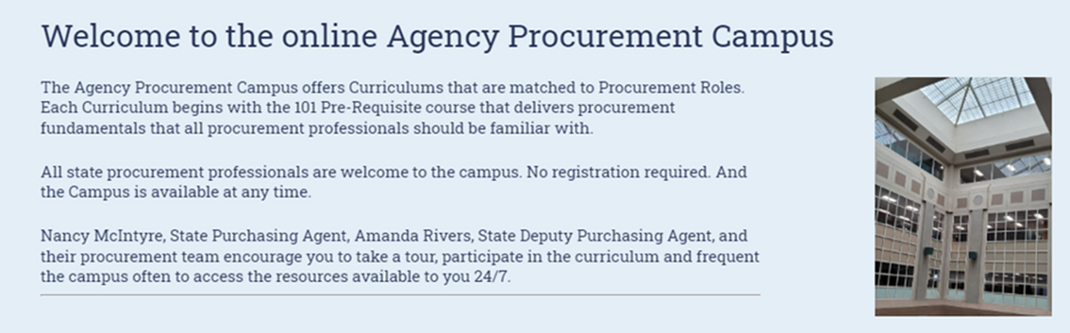
PROCUREMENT CAMPUS
Training curriculum based on agency personnel procurement role:
  Pre-Requisite
  Requisition
  Contract Manager
  Procurement & Solicitation Professional
  Leadership

Slide 42
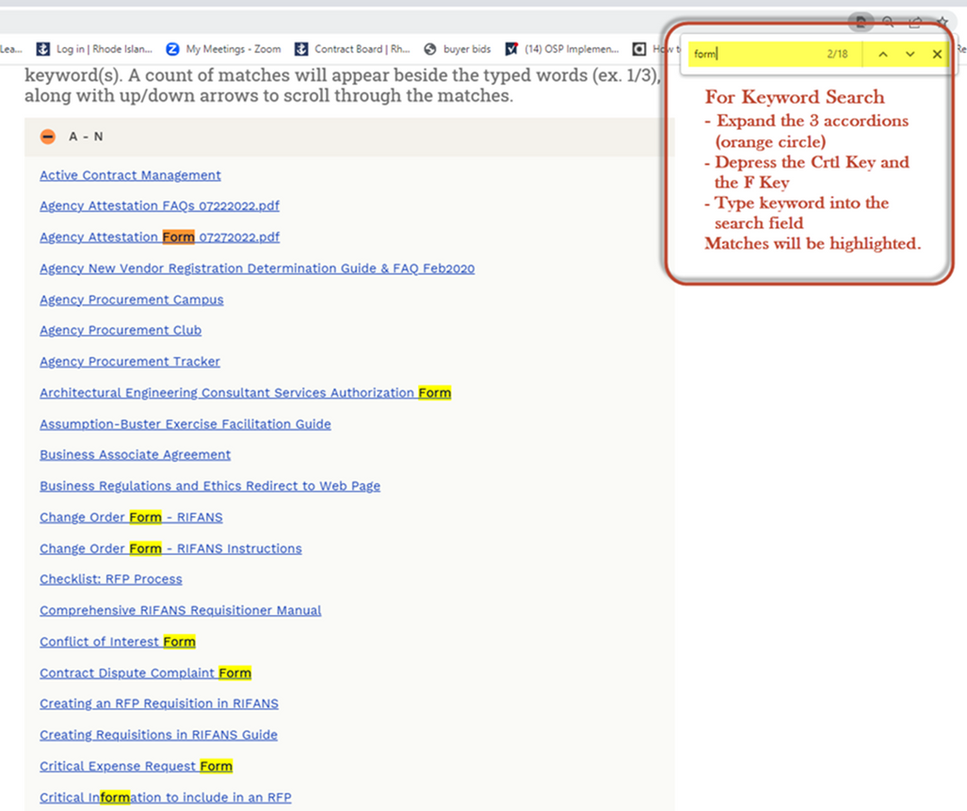
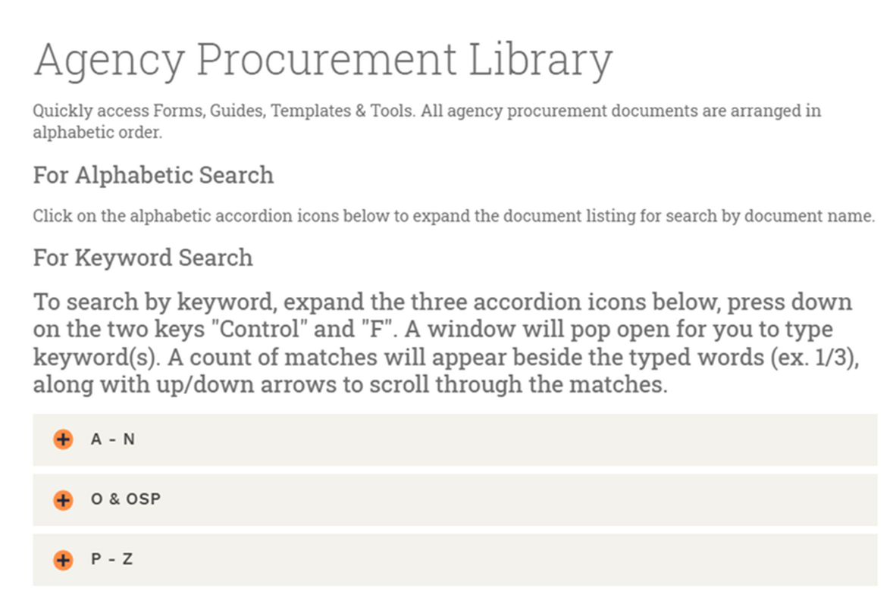
PROCUREMENT LIBRARY
Quickly access all procurement resources at the Library, including all resources in the PROC Curriculum Modules.
42

Slide 43

RESOURCES
  Purchases’ website: https://ridop.ri.gov.
  Purchases Procurement Team
    Administrator of Purchasing Systems
      Tom Bovis - Construction (and related goods and services)
      David Francis - Health & Human Services (and related goods and services)
      Maxwell Righter - Information Technology and General Goods and Services
    Assigned Procurement Specialist
    Purchases’ Leadership

Slide 44

THANK YOU
Thank you for your time and interest in better understanding the regulatory mandates, ethics, organizational structure, procurement types and business processes of the Division of Purchases.
Jay Hauser, State Purchasing Agent
Amanda Rivers, Deputy Purchasing Agent
Meredith Skelly, Deputy Purchasing Agent

